Slide 1
Interactive Recommendations in Social Endorsement Networks
Theodoros Lappas and Dimitrios Gunopulos
RecSys 2010
July 27, 2011
Hyewon Lim

Slide 2
Outline
Introduction
Extraction of Popular Groups
Group Tagging
Eliminating Redundancy
Interactive Recommendations
Experiments
Conclusion

Slide 3
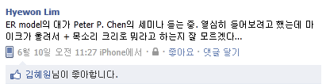
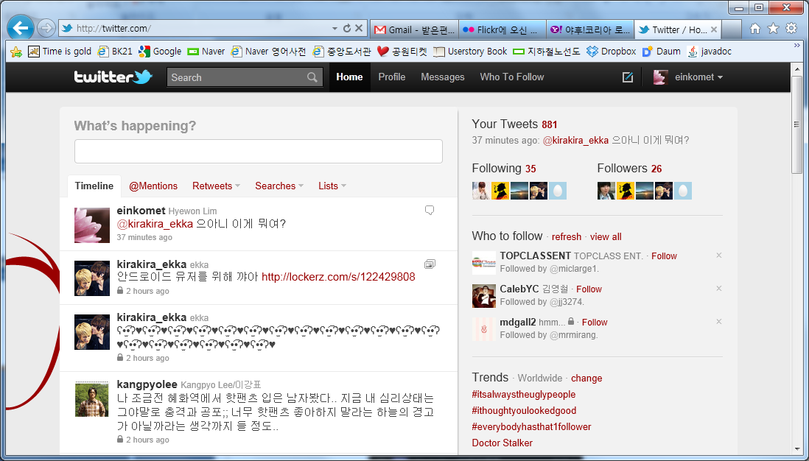
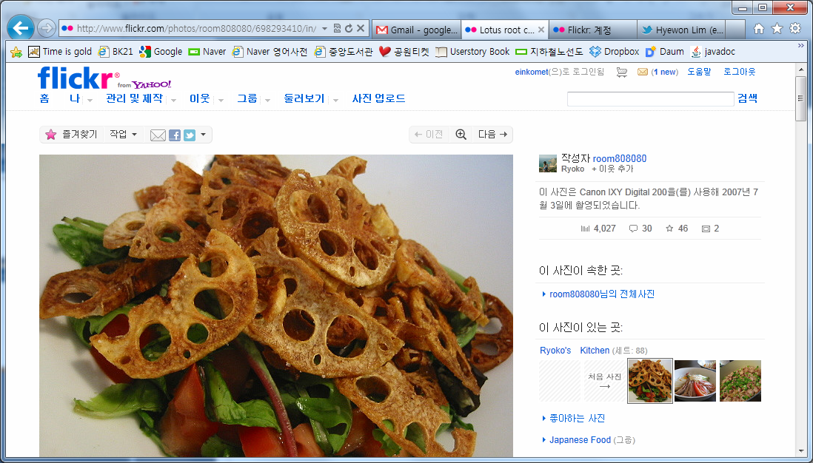
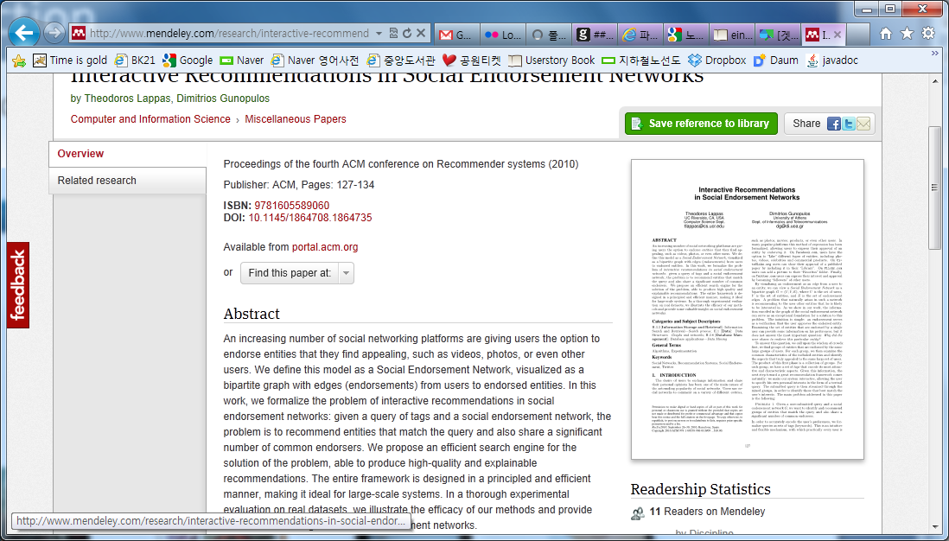
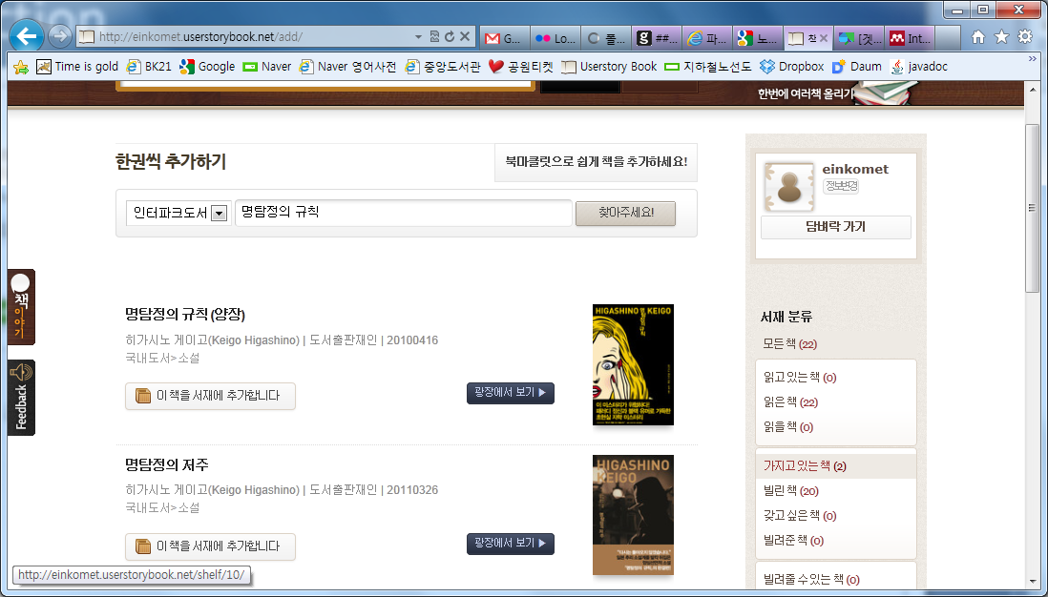
Introduction

Slide 4


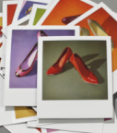
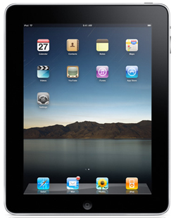
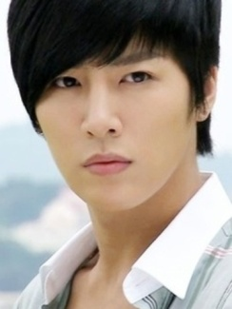
Introduction
Social Endorsement Network

Slide 5
Introduction
Problem 1. Given a user-submitted query and a social endorsement network G, we want to identify and recommend groups of entities that match the query and also share a significant number of common endorsers
Queries
Facebook: Recommend Chinese Restaurants in San Fransisco
CiteULike: Recommend research papers on Social Networks
Twitter: Recommend female singers from the USA
“Whitney Houston, Mariah Carey and Celine Dion match
The query and also share 50,000 followers.”
Notes:
The interaction with the user and the authority offered by the large number of common endorsers make our recommendations explainable and intuitive to the user.

Slide 6
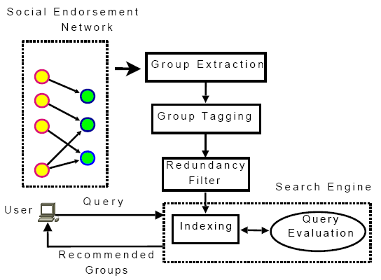
Introduction
An overview of the framework

Slide 7
Extraction of Popular Groups
Produce an initial collection of popular entity-groups
Problem of mining frequent item sets
Problem 2. Given a social endorsement network G = (U, V, E) and a group of endorsed entities g ∈ 2^{V}, let N(g) return the set of common endorsers of g in G. Then, find the set of entity-groups G, so that
G = {g | g ∈ 2^{V}, |N(g)| ≥ T}
Notes:
수식: all groups that have at least T endorsers in common.
-> 실험파트에서 T의 값을 조정하는 것이 reported groups의 수에 어떤 영향을 미치는지 보여줌.

Slide 8
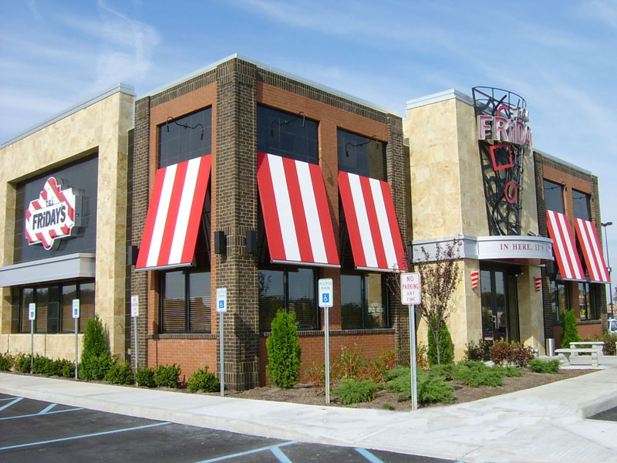
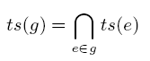
Group Tagging
“Why where these entities endorsed by the same large set of users?”
Identify the common characteristics that make these entities appealing to the same crowd
Notes:
레스토랑 -> 위치, 음식 등등의 정보를 얻을 수 있다. 이런걸 태그로 표현하겠다는 것.

Slide 9
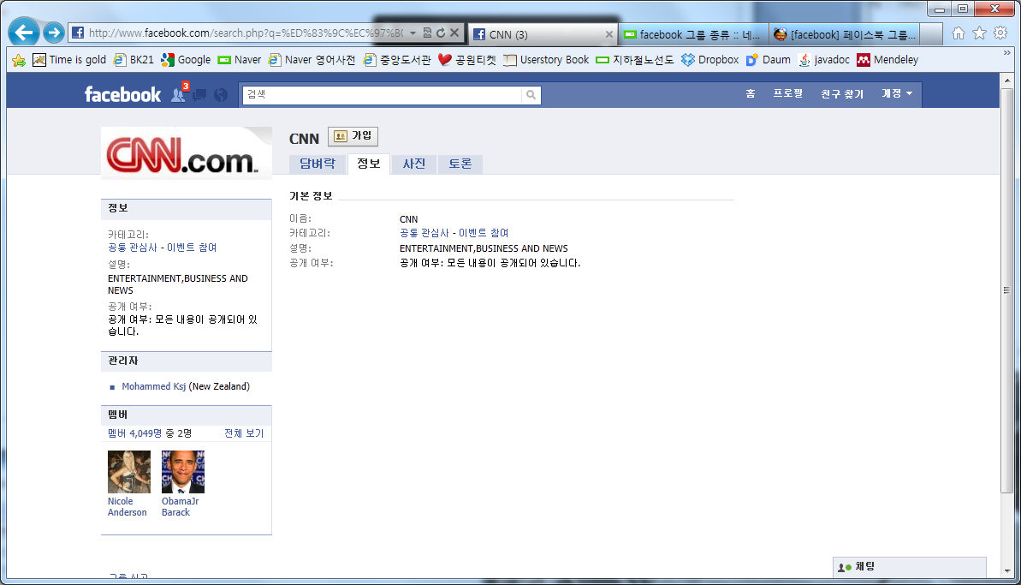
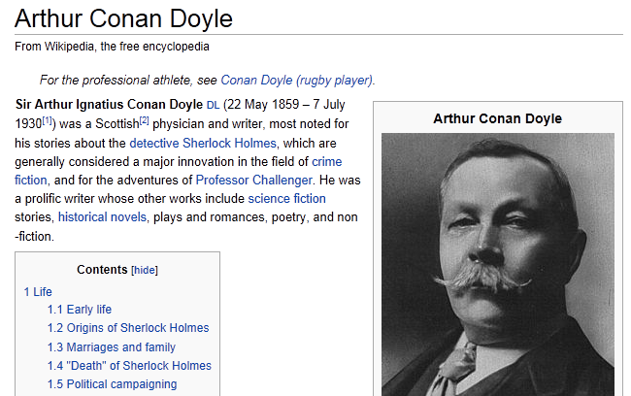
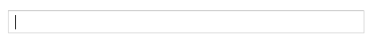
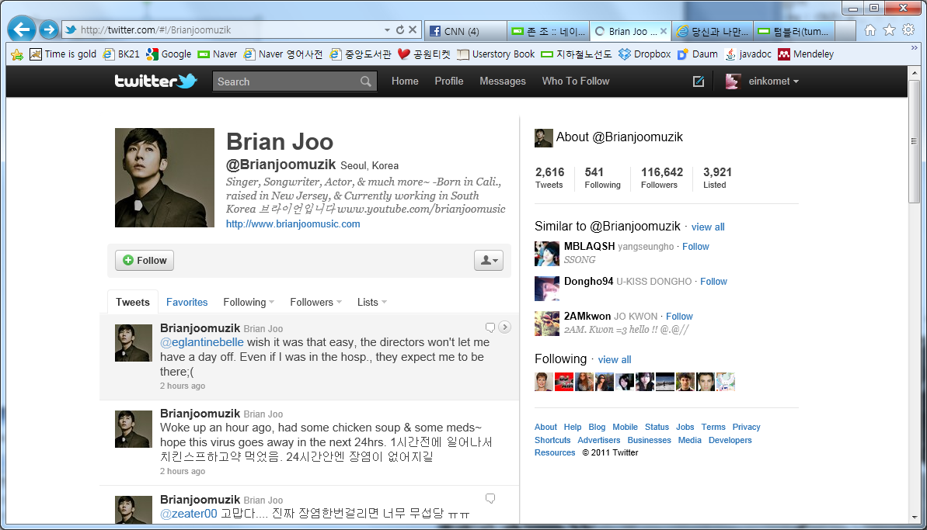
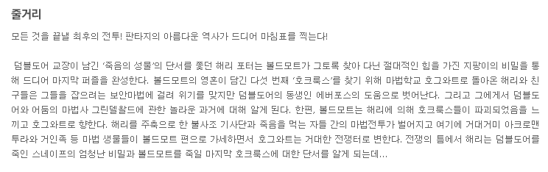
Group Tagging
Getting tags

Slide 10
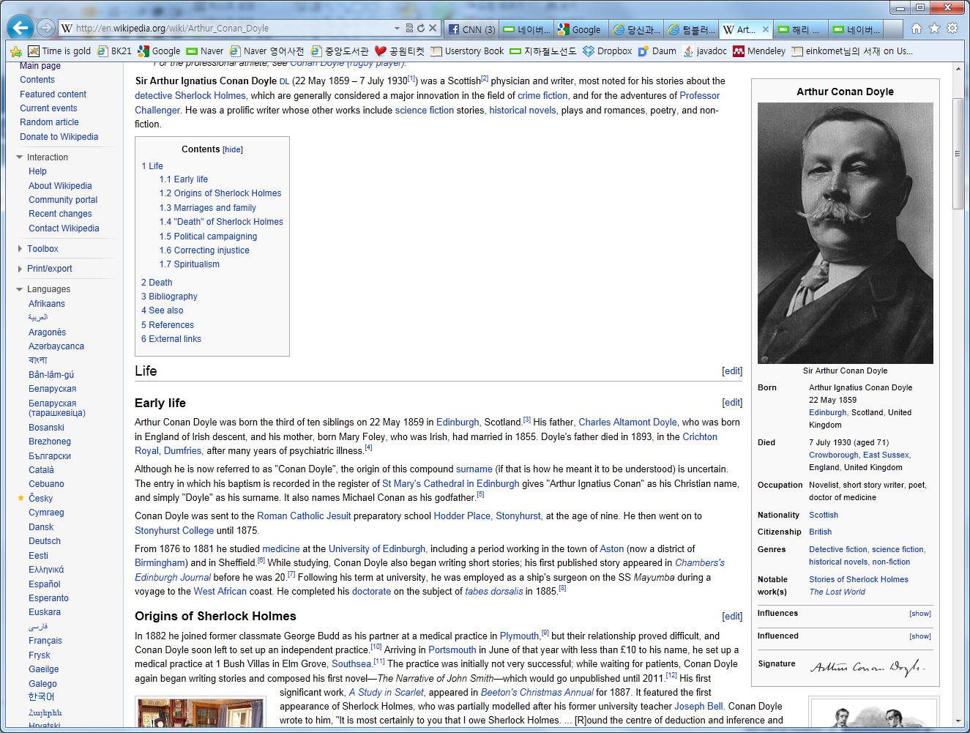
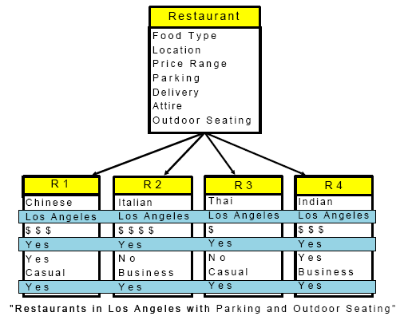
Group Tagging
Structured Content
Templates facilitate the direct extraction of informative tags
A fixed set of attributes
Easier to identify common characteristics and decode the correlation among the members of a group
Food Type
Location
Price Range
Parking
Delivery
Attire
Outdoor Seating

Slide 11
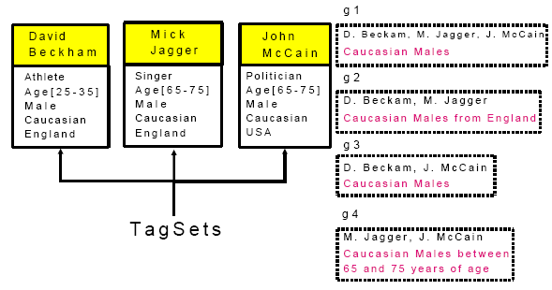
Eliminating Redundancy
GroupFilter Algorithm
Problem 3. Given a set of groups G, find a filtered set G* ⊆ G, so that: 1. ∀g ∈ G,∃g’ ∈ G * s.t., {ts(g) ⊆ ts(g’) and g ⊆ g’} 2. G* is the smallest set among all those that satisfy the 1st condition

Slide 12
Interactive Recommendations
Problem 4. Given a set of entity-groups G = {g₁, g₂, …, g_{n}} and a query of tags q = {t₁, t₂, …, t_{m}}, find the k largest groups from G that satisfy the following condition:
ts(g) ⋂ t_{i} ≠0, ∀t_{i} ∈ q
Use an inverted index
Mapping each tag to the list of groups that contain it
Groups in each list are sorted by their size and by the # of endorsers
TopKFinder Algorithm

Slide 13
Interactive Recommendations
TopKFinder Algorithm
Q1
{A, B, C, D}
{A, B, C}
{A, B, D}
…
Q2
{A, B, D, E}
{A, B, D}
{A, D, E}
…
List 1
{A, B, D}
{A, B}
{B, D}
…
Top-K
{A, B, D}
{A, B}
List 2

Slide 14

Experiments
Datasets
Twitter dataset
DBLP dataset
Britney Spears
Music Artist
TV Personality
Athlete
Business Person
Other
Ashton Kutcher
Evan Williams
Oprah Winfrey
Jiawei Han
R. Agrawal
Stefano Ceri
Serge Abiteboul

Slide 15
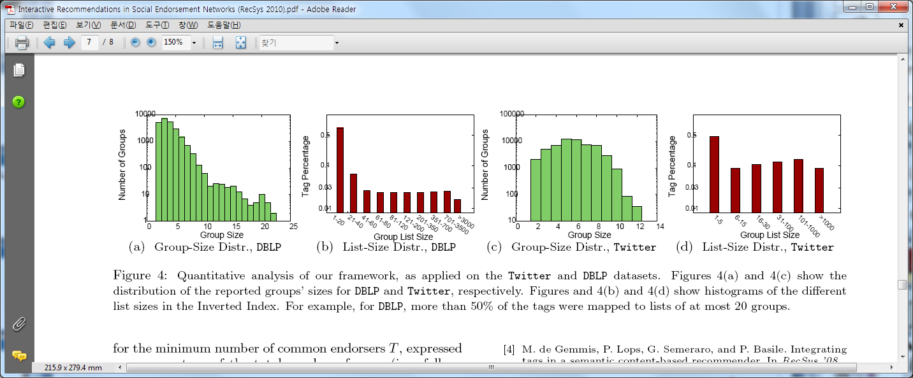
Experiments Quantitative Analysis
Group size distribution
Inverted index
Notes:
Group size distribution:
DBLP의 경우 2-10명 그룹이 일반적. 20명 넘는 건 극히 드뭄.
Inverted index:
DBLP의 경우 태그의 50% 이상이 1-20크기의 group에 포함됨.
3000이상의 크기를 갖는 group에 맵핑되는 tag는 2%정도임.
상위 3개의 tag는 Databases, systems, data로 각각 22326, 20015, 19645개의 그룹에 나타남
Twitter의 경우 50%정도의 태그가 1-5크기의 group에 포함됨.
상위 3개의 tag는 Male, Age[30-40], TV Personality로 각각 48033, 2441, 2054개의 그룹에 나타남

Slide 16
Experiments Qualitative Analysis
Create a set of 10 queries for each dataset
DBLP
9 queries from the session names of the SIGKDD 2006
One query for relevance
Twitter
Popular tags from the corpus
For each query
Report the top-1 group of entities and the number of common endorsers per group

Slide 17
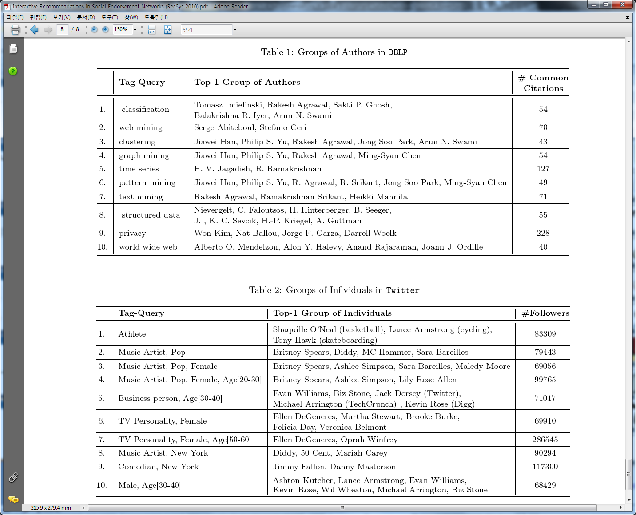
Experiments Qualitative Analysis
Results for DBLP
Highly-cited and well-known authors
Authors with numerous papers
more likely to have larger, more diverse TagSets that overlap with those of other authors
Co-authorships (#9)
Notes:
-많은 논문을 쓴 저자는, 인용될 확률도 높지만, 다른 저자들과 다양하고 많은 tag들이 겹칠 가능성도 높음.
-공동저자같은 경우 group의 포메이션을 형성하기 위한 요소가 될 수 있음. 9번 질의 ‘privacy’의 결과로 나온 저자 4명은 “A Distributed Object-Oriented Database System Supporting Shared and Private Databases”라는 많이 인용된 논문을 함께 썼음.

Slide 18
Experiments Qualitative Analysis
Results for Twitter
Well-known in their respective fields
Less focused queries lead to more diverse groups (#10)
From general to focused one: #2, #3, #4
#3 -> #4: more followers because of the group size
Notes:
#10 결과 그룹은 배우 2, 운동선수 1, 경영인 4로 구성됨.

Slide 19
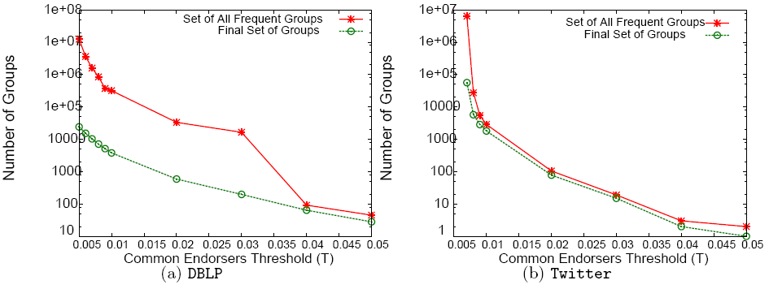
Experiments Redundancy Filtering
Evaluate the redundancy filter for the minimum number of common endorsers T
Notes:
DBLP의 경우에는 redundancy filter가 unfiltered set의 상당부분을 잡아줌으로써 컴팩트하고 informative한 set들을 만들어내는 걸 알 수 있다.
Twitter의 경우, T가 커질 수록 unfiltered set의 크기가 매우 적기 때문에 따라서, filtering할 애들이 적게 된다.
그러나 T가 작은 경우에는 redundancy filter가 효과를 내는 것을 알 수 있다. T=0.007일 때, 6436171개에서 56695개로, T=0.008일 때 27410개에서 5756개로 줄어들었음을 볼 수 있다.

Slide 20
Conclusion
Formalized the problem of interactive recommendations in social endorsement networks
Presented an efficient, query-driven framework for the solution of the problem
Filtering mechanism

